Slide 1

ELIZA AI Oracle on Sui: Your On-Chain Life Coach
Embark on a journey of self-discovery with ELIZA, your AI-powered oracle on the Sui blockchain. Uncover insights and guidance for your life's path.

Slide 2
What is ELIZA? AI-Powered Conversations Explained
The Original ELIZA
AI-Powered Conversations
Simple Rules
ELIZA is a natural language processing computer program. It was developed in 1966 at the MIT AI Lab. It simulates conversation using pattern matching.
ELIZA uses keywords and rules. It responds in a way that mimics human conversation. It was designed to act like a Rogerian psychotherapist.
The original ELIZA does not possess true understanding. It relies on simple techniques. It uses these to generate surprisingly human-like interactions.

Slide 3
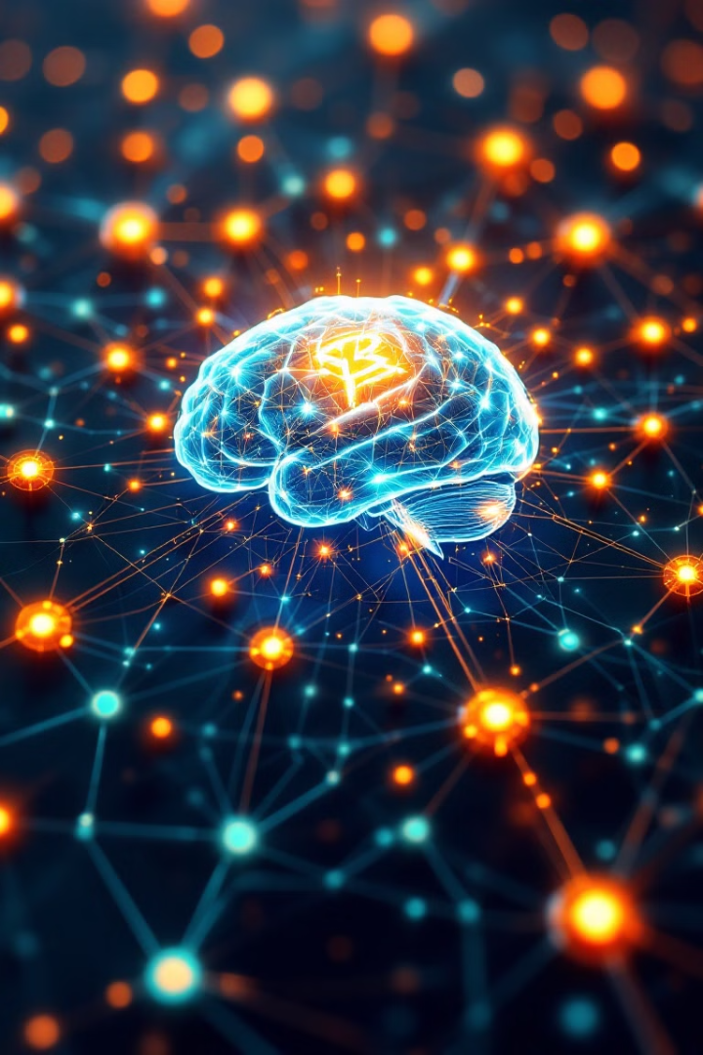
Project Background: Integrating AI with Blockchain for Secure Oracles
1
Secure & Transparent
2
Sui Blockchain
ELIZA on Sui combines AI with blockchain technology. This creates secure and transparent AI-driven oracle services.
It leverages the Sui blockchain's capabilities. This ensures fast transactions with low gas fees, improving the user experience.
3
Decentralized AI
The project aims to create a decentralized, trustworthy platform. This platform provides AI-driven insights and predictions.

Slide 4
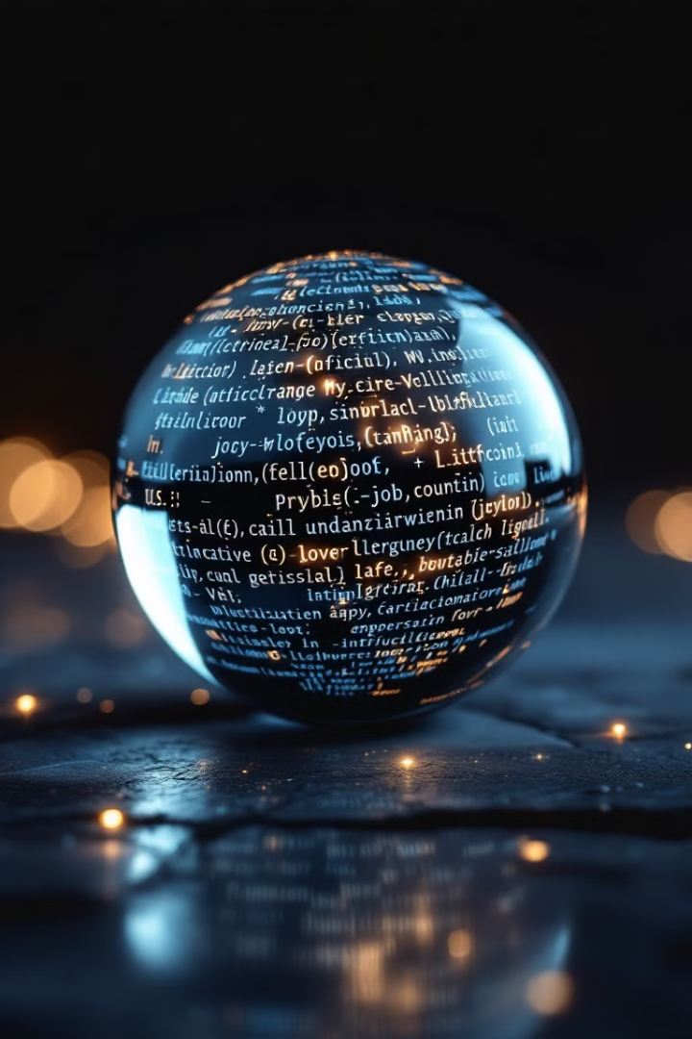



Core Functionality: Personalized Readings & Sui Chain Integration
AI Divination
Sui Integration
Secure Oracle
ELIZA's AI provides personalized divination based on user input. It offers unique insights.
Sui integration ensures fast, low-cost transactions. This enhances user experience.
Blockchain technology guarantees security. It also ensures the integrity of readings.

Slide 5

Use Cases: Exploring the Potential of AI-Driven Divination
Personal Guidance
1
Users can seek advice on life decisions. They gain insights from ELIZA's AI readings.
2
Entertainment
ELIZA provides fun and engaging entertainment. It offers unique AI-generated stories and predictions.
Blockchain Gaming
3
Integrate ELIZA into blockchain games. It can provide dynamic storylines and personalized quests.
4
NFT Integration
Link ELIZA readings with NFTs. Create unique, AI-generated NFT experiences.

Slide 6





The Future of AI Oracle Services on Sui
Expanded AI
Integrating more sophisticated AI models for deeper insights.
Community Growth
Building a vibrant community around AI and blockchain.
Partnerships
Collaborating with other projects in the Sui ecosystem.
New Use Cases
Discovering innovative applications of AI oracles.

